Slide 1
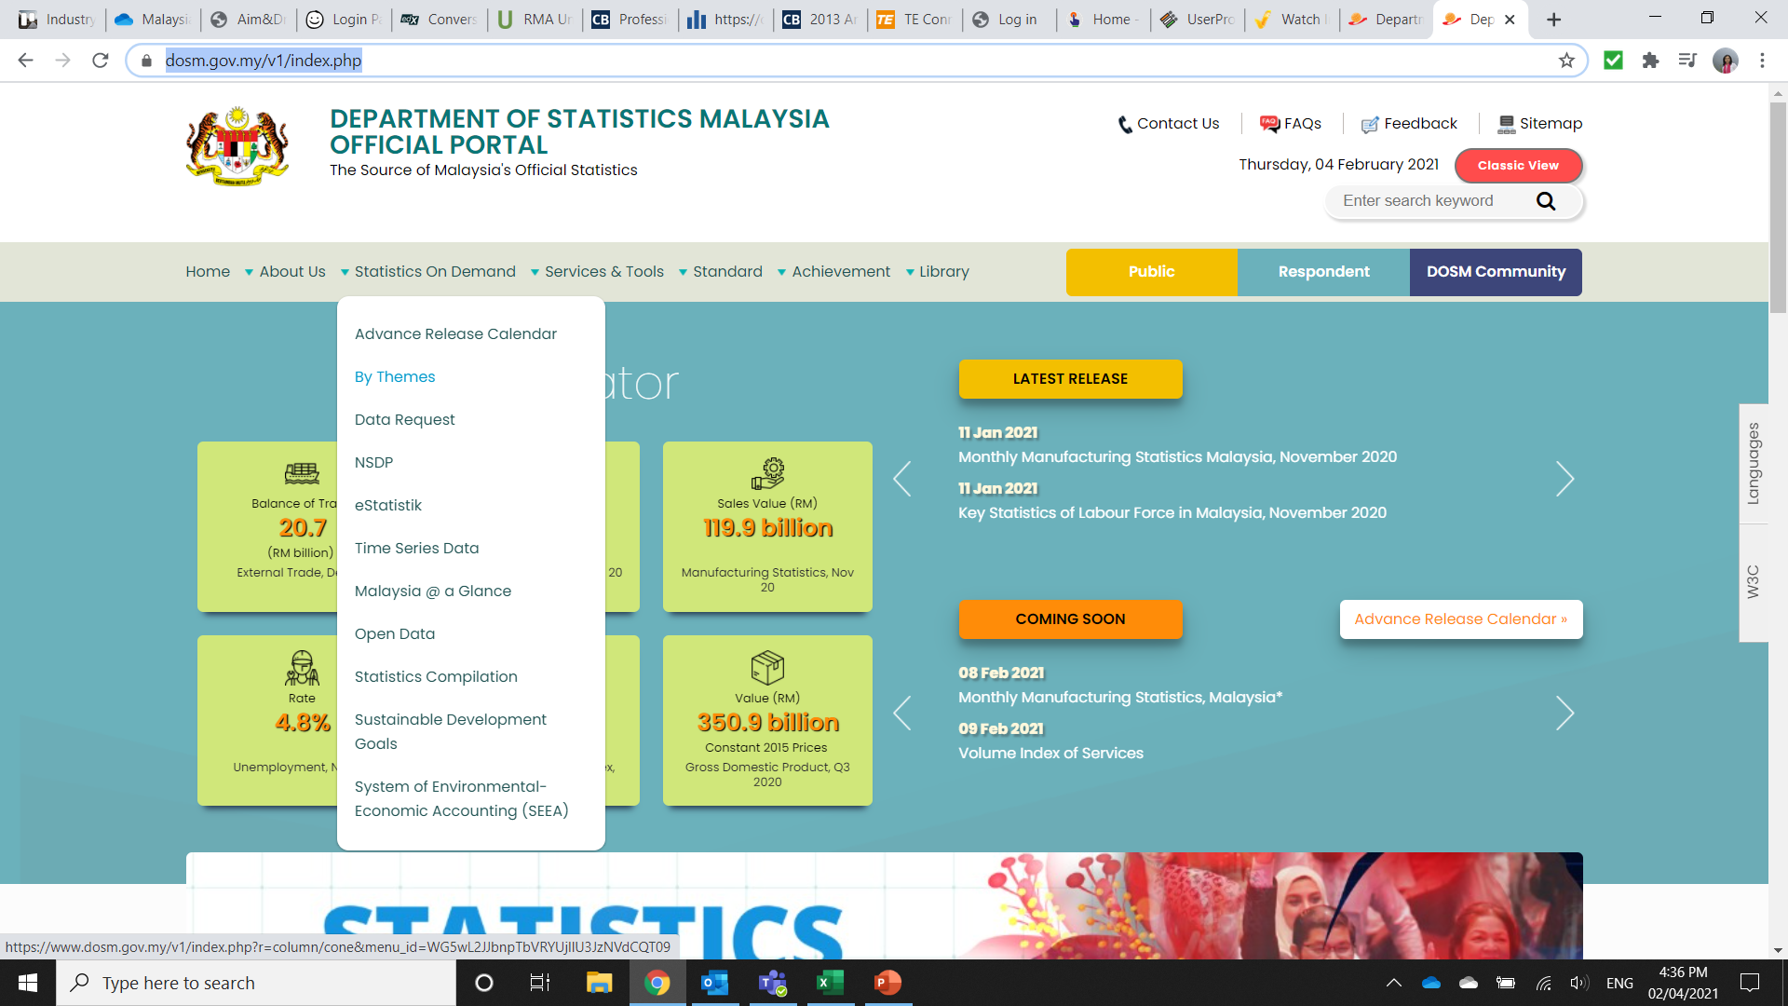
Procedure to obtain PPI data for Malaysia
Go to:
Move the cursor to “Statistics on Demand”
From the drop down, click on “eStatistik”
https://www.dosm.gov.my/v1/index.php

Slide 2
Procedure to obtain PPI data for Malaysia
Register for a User ID and Password
After receiving your login details, come back to this page and click ‘Free Download’
3.
4.

Slide 3
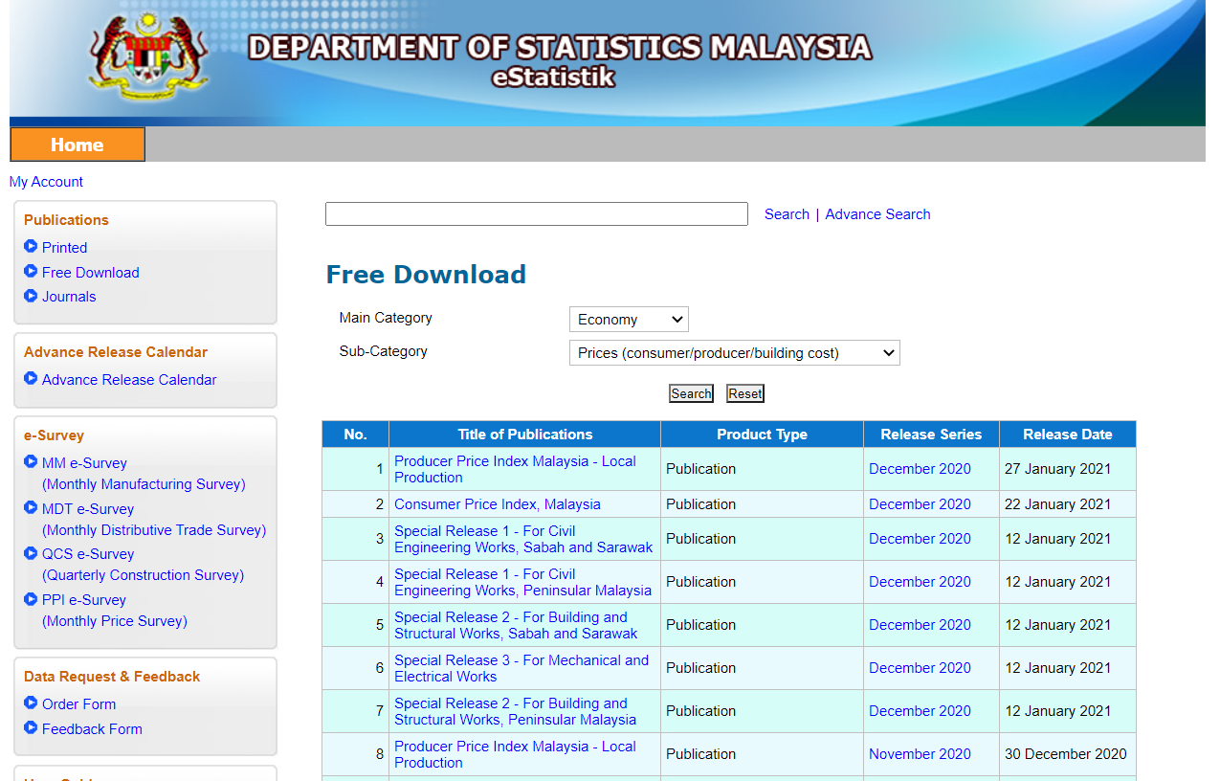
Procedure to obtain PPI data for Malaysia
Under “Main Category” Select “Economy”
Under “Sub-Category” Select “Prices (consumer/producer/building cost)” and click on search
In the table below, select “Producer Price Index Malaysia – Local Production” for the time period required

Slide 4
Procedure to obtain PPI data for Malaysia
Select the format required to download the PPI data

Slide 5
Procedure to obtain PPI data for Malaysia
The PPI is different tables and worksheets, which ever type is required can be copied from here

